Slide 1
Tableau Tutorial
File created on: 6/10/2024 6:03:58 PM

Slide 2
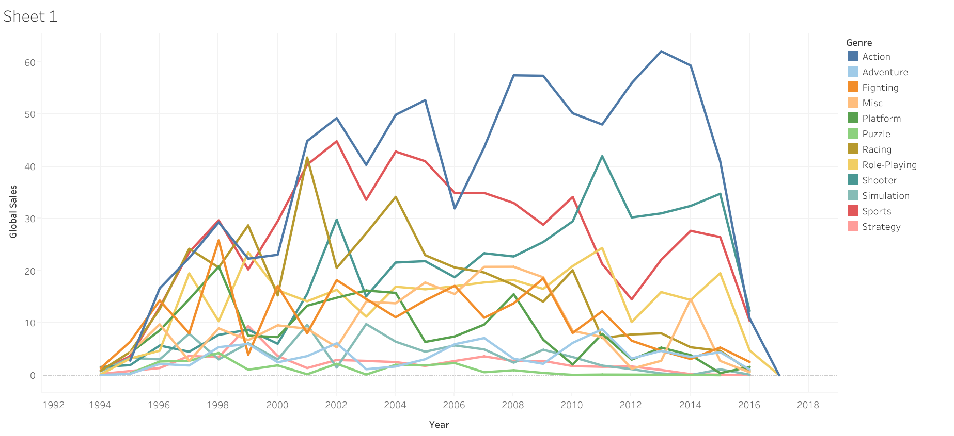

Slide 3
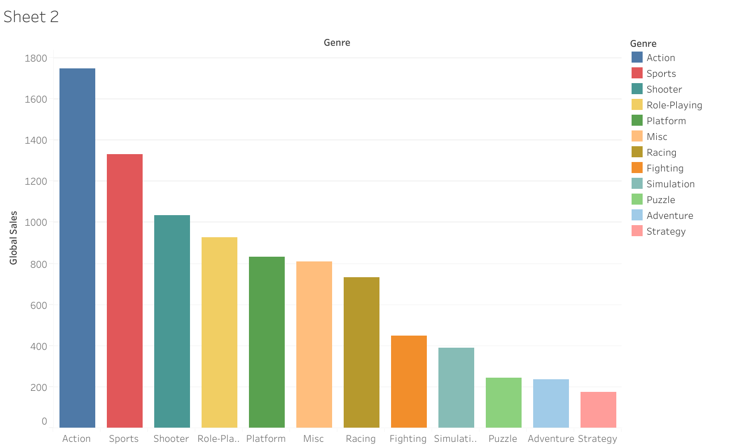

Slide 4
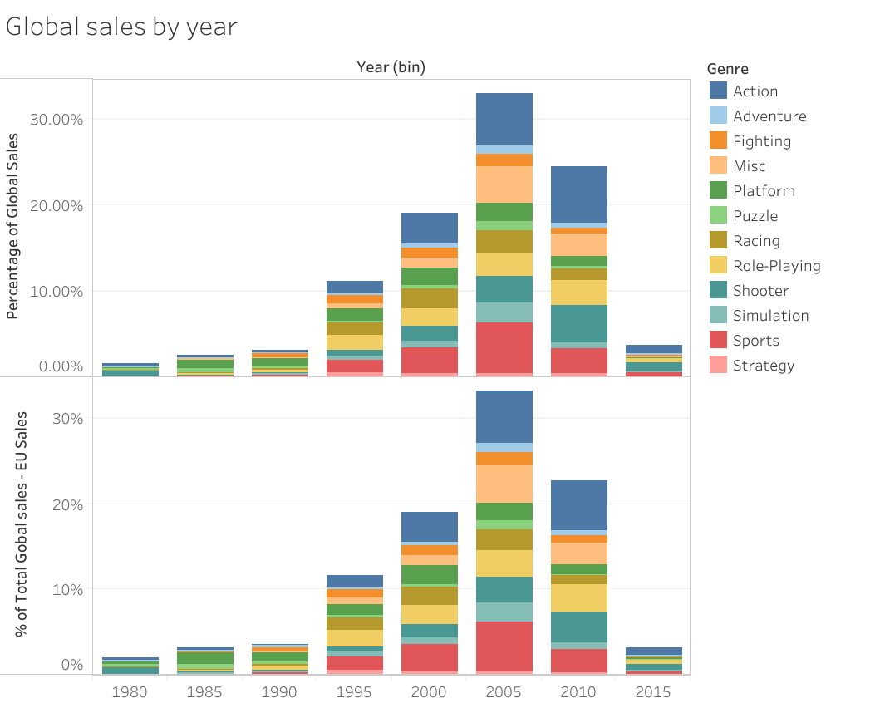

Slide 5
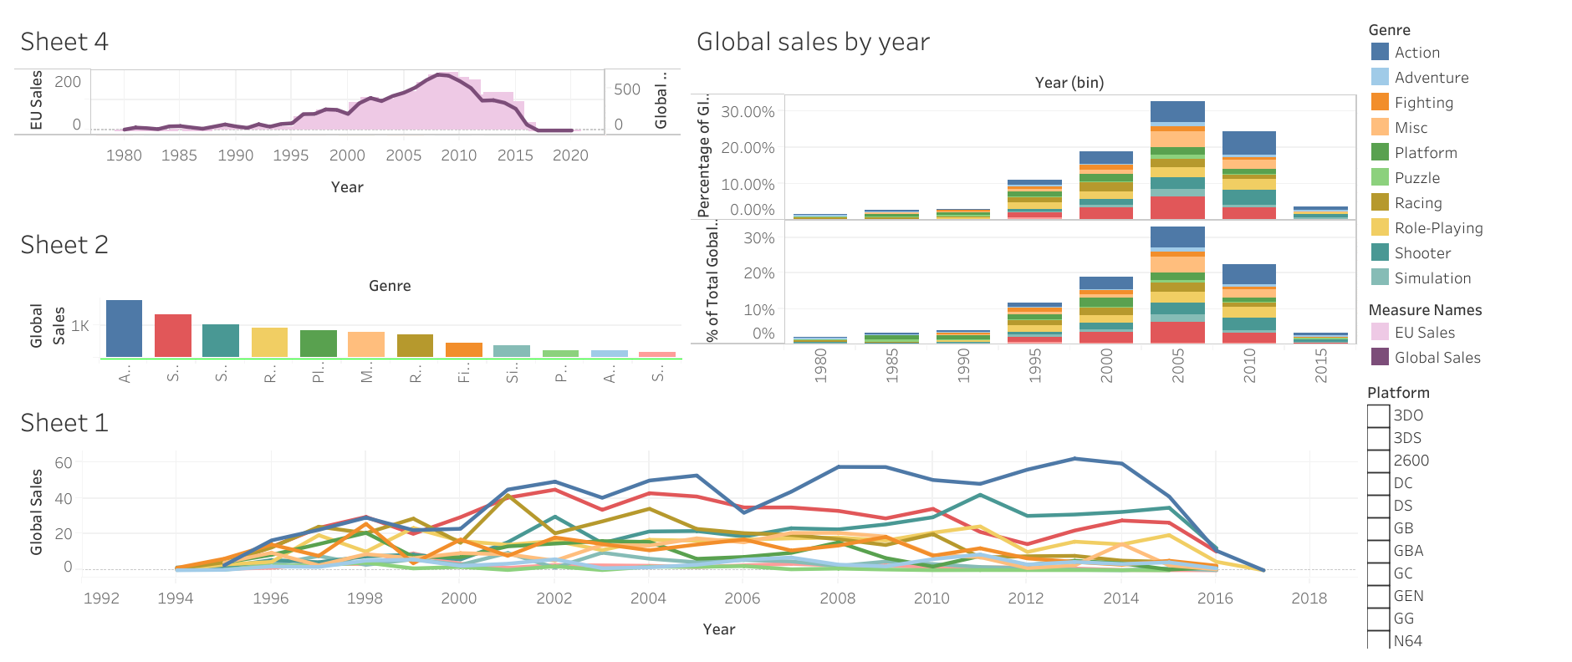

Slide 6
